Slide 1
CS2S562
Secure Software Development
File I/O

Slide 2
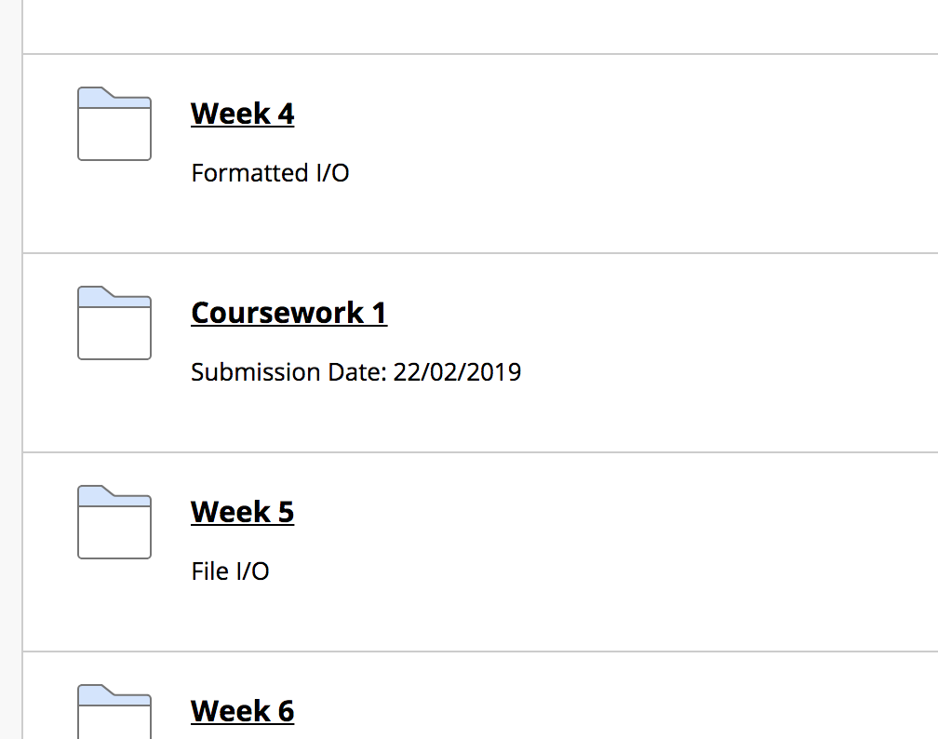
Coursework 1
Started last week (week 4)
  See ‘Learning Materials’ page of module on BlackBoard
Detailed guide
  Just inside the Coursework folder

Slide 3
Today
Classic C file I/O
  fprintf, fscanf and many more
File I/O in C++ using streams
  Can process entire structs in one go. Fast.
Both C and C++
  File I/O can go wrong in several places
  Apply a triple lock
Some non-obvious vulnerabilities

Slide 4

Classic C File I/O
(Welcome to the Zoo)
Classic C File I/O (C: stdio.h, C++: cstdio)
  File access: fopen, fclose, fflush, (and 4 others)
  Direct I/O: fread, fwrite
  Unformatted I/O: fgets, getc, fputc, putc, (and 15 others)
  Formatted I/O: fprintf, fscanf, (and 24 others)
  File positioning: fseek, rewind, (and 3 others)
  Error handling: feof, ferror, clearerr
  File operations: remove, rename, tmpfile
  Constants: EOF, NULL, _IOFBF, (and 13 others)
  Format specifiers: %d, %f, %1.4f, ...
  The safe _s versions: fopen_s, fscanf_s, …
Notes:
OK so this is one of the problems perhaps of C being an old language that has undergone lots of change; there are lots of libraries that can be used to input and output files. It’s a jungle out there!

Slide 5

Classic C File I/O
Example
Setting-up
#include <stdio.h> // for printf, fprintf and fscanf
#include <stdint.h> // for int32_t et al.
#include <stdlib.h> // for system("Pause")
void main()
{
FILE *fp; // Pointer to file
char x = 'B'; // A few
int32_t y = 100; // variables to
float z = 2001.0; // play with
Saving
// ================ WRITE TO FILE =================
fopen_s(&fp, "test.dat", "w"); // w=open for writing
if (fp == NULL)
{
printf("File could not be opened for writing");
}
else
{
fprintf(fp, "%c\n", x); // Write the char
fprintf(fp, "%d\n", y); // Write the int16_t
fprintf(fp, "%f\n", z); // Write the float
fclose(fp); // Important!!
}
// ================================================
Loading
// =============== READ FROM FILE ================
fopen_s(&fp, "test.dat", "r"); // r=open for reading
if (fp == NULL)
{
printf("File could not be opened for reading");
}
else
{
fscanf_s(fp, "%c", &x, 1); // Read the char
fscanf_s(fp, "%d", &y, 1); // Read the int16_t
fscanf_s(fp, "%f", &z, 1); // Read the float
fclose(fp); // Important!!
}
// ================================================
printf("x=%c y=%d and z=%f \n",x,y,z);
system("Pause"); // creates 'Any key to continue'
return;
}
x = ' '; // Reset variables
y = 0; // to demonstrate
z = 0; // that read-in works
Example uses _s functions i.e. not portable to pre C11 programs

Slide 6

Classic C File I/O
The problem is…
  Classic C file I/O suffers from the same
  problems as classic C keyboard I/O (last lecture)
    formatted I/O can be exploited (variadic functions & format strings)
    unformatted I/O requires:
        normalisation,
        canonicalisation,
        sanitisation
        validation
Even the _s functions are not really safe
  If we change the int32_t to int16_t:
  We get this:
  (%d expects 16 bit)
char x = 'B'; // A few
int16_t y = 100; // variables to
float z = 2001.0; // play with

Slide 7

Classic C File I/O
However …
  Although well in Jurassic Park territory, classic file I/O is still widely used in creating new and maintaining existing programs:

Slide 8


C++ File I/O
File I/O using C++ Streams
  #include <fstream>
  Used with try and catch for error handling
  Can serialise objects and structs to disk
  much less clutter and function proliferation

Slide 9
C++ File I/O
Serialisation of structs via Streams
#include <fstream> // for file I/O functions
#include <iostream> // for cout
using namespace std;
// Precaution to have always the right array sizes
const int MAX_CHARS = 10;
const int MAX_STUDENTS = 2;
// Structure definition
typedef struct
{
char name[MAX_CHARS];
int age;
bool male;
}student_t;
void main()
{
// Create array of structs for holding data
student_t studToSave[MAX_STUDENTS];
// Seeding data into struct array
strncpy_s(studToSave[0].name, "John", MAX_CHARS);
studToSave[0].age = 21;
studToSave[0].male = true;
strncpy_s(studToSave[1].name, "Mary", MAX_CHARS);
studToSave[1].age = 22;
studToSave[0].male = false;
// Serialising struct to students.data
ofstream output_file("students.data", ios::binary);
output_file.write((char*)&studToSave, sizeof(studToSave));
output_file.close();
// Create struct array to hold data to be read-in
student_t studLoaded[MAX_STUDENTS];
// Reading from from file again
ifstream input_file("students.data", ios::binary);
input_file.read((char*)&studLoaded, sizeof(studLoaded));
input_file.close();
// Displaying data
for (size_t i = 0; i < MAX_STUDENTS; i++)
{
cout << "Record #" << i << endl;
cout << "Name: " << studLoaded[i].name << endl;
cout << "Age: " << studLoaded[i].age << endl;
cout << "Gender: ";
if (studLoaded[i].male) cout << "male";
else cout<<"female";
cout << endl;
}
system("Pause"); // creates 'Any key to continue'
return;
}
The problem here:
What happens if students.data can't be created or accessed?

Slide 10
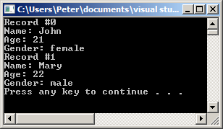

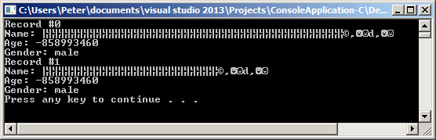
C++ File I/O
So, instead of this:
We get this
This file doesn't exist
char name[10] may get a buffer overflow !!!
(int age is just weird)

Slide 11
C++ File I/O
use the fail() method:
// Reading from from file again
ifstream input_file("xxxxxx.data", ios::binary);
if (input_file.fail())
{
cout << "Could not open file" << endl;
}
else
{
input_file.read((char*)&studLoaded, sizeof(studLoaded));
input_file.close();
// Displaying data
for (size_t i = 0; i < MAX_STUDENTS; i++)
{
cout << "Record #" << i << endl;
cout << "Name: " << studLoaded[i].name << endl;
cout << "Age: " << studLoaded[i].age << endl;
cout << "Gender: ";
if (studLoaded[i].male) cout << "male";
else cout << "female";
cout << endl;
}
}
The problem now:
What happens if .read() goes wrong, e.g. file is on memory stick that gets removed while reading is in progress?

Slide 12
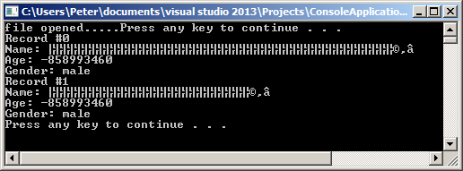
C++ File I/O
// Reading from file again
ifstream input_file("k:\\students.data", ios::binary);
if (input_file.fail())
{
cout << "Could not open file" << endl;
}
else
{
cout << “file opened.....”; // pull mem.stick now
system("Pause"); // creates 'Any key to continue'
input_file.read((char*)&studLoaded, sizeof(studLoaded));
input_file.close();
// Displaying data
for (size_t i = 0; i < MAX_STUDENTS; i++)
{
cout << "Record #" << i << endl;
cout << "Name: " << studLoaded[i].name << endl;
cout << "Age: " << studLoaded[i].age << endl;
cout << "Gender: ";
if (studLoaded[i].male) cout << "male";
else cout << "female";
cout << endl;
}
}
memory stick
Result

Slide 13
C++ File I/O
Use the boolean return of read()
and check the amount of bytes
Triple lock:
File not existing or can't be opened
Problem during file read
File may have more or less data than expected
… and the same 3 steps for writing as well…
ifstream input_file("students.data", ios::binary);
if (input_file.fail())
{
cout << "Could not open file" << endl;
}
else
{
if (!input_file.read((char*)&studLoaded, sizeof(studLoaded)))
{
cout << "Could not read file" << endl;
}
else
{
streamsize bytesRead = input_file.gcount();
if (bytesRead != sizeof(studLoaded))
{
cout << "Could not read expected number of bytes" << endl;
}
else
{
// Displaying data
for (size_t i = 0; i < MAX_STUDENTS; i++)

Slide 14
C++ File I/O
An the same for writing:
Triple lock:
File can't be opened
Problem during file write
File may have more or less data than expected
… all very tedious – but safe! Well, almost because …
// Serialising struct to students.data
ofstream output_file("students.data", ios::binary);
if (output_file.fail())
{
cout << "Could not open file for writing" << endl;
}
else
{
if (!output_file.write((char*)&studToSave, sizeof(studToSave)))
{
cout << "Could not write file" << endl;
}
else
{
streamsize bytesWritten = output_file.tellp();
if (bytesWritten != sizeof(studToSave))
{
cout << "Could not write expected number of bytes" << endl;
}
else
{
cout << "file written OK" << endl;
}
}
}

Slide 15
File I/O Vulnerabilities
Lang | Description | Severity | Likelihood | Remediation Cost | Risk
C | Avoid TOCTOU race conditions while accessing files | 3 | 2 | 3 | 18
C | Distinguish between characters read from a file and EOF | 3 | 2 | 2 | 12
C | Do not assume that fgets() returns a nonempty string when successful | 3 | 2 | 2 | 12
C | Do not alternately input and output from a stream without an intervening flush or positioning call | 1 | 3 | 2 | 6
C | Close files when they are no longer needed | 2 | 1 | 2 | 4
C | Do not access a closed file | 2 | 1 | 2 | 4
Table data after CERT.org
Note: ‘C’ in above table means ‘C and C++’

Slide 16
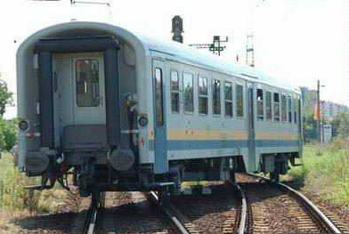
TOCTOU Race Conditions
TOC – what?:
  Time-Of-Check, Time-Of-Use
  Can happen if two or more concurrent
  processes operate on a shared file, e.g.:
    first access: check to verify something
    next access: use of the file.
  An attacker can alter the file between the two accesses, or replace the file with a symbolic or hard link to a different file.
  A program that performs two or more file operations on a single file name or path name creates a race window between the two file operations.
  Problem is the assumption that the file name refers to the same resource both times. If an attacker can modify the file, remove it, or replace it with a different file, then this assumption will not hold.
  It is not necessarily an attacker, it could be the program itself

Slide 17
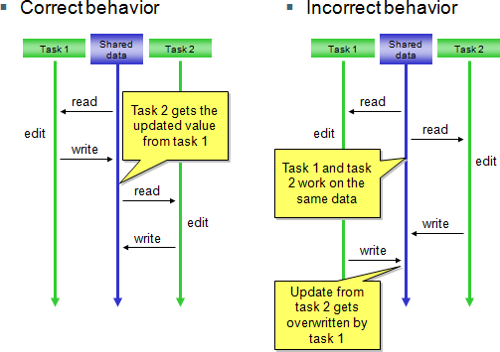
TOCTOU Race Conditions
Illustration:
Source: http://blogs.windriver.com/engblom/2010/06/true-concurrency-is-truly-different-again.html

Slide 18
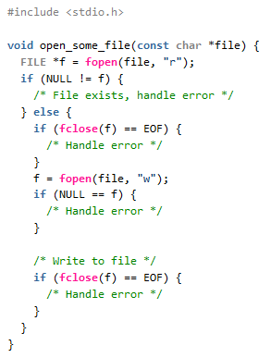
TOCTOU Race Conditions
Example from CERT:
This code tries to prevent an existing file from being overwritten by first opening it for reading before opening it for writing.
An attacker can exploit the race window between the two calls to fopen() to overwrite an existing file.

Slide 19
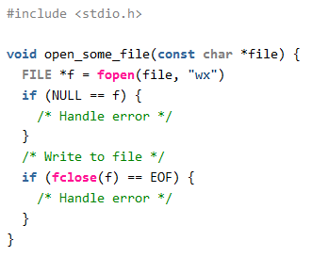
TOCTOU Race Conditions
Solution:
The solution invokes fopen() at a single location and uses the x mode of fopen (added in C11).
This mode causes fopen() to fail if the file exists. This check and subsequent open is performed without creating a race window.

Slide 20

File I/O Vulnerabilities
Lang | Description | Severity | Likelihood | Remediation Cost | Risk
C | Avoid TOCTOU race conditions while accessing files | 3 | 2 | 3 | 18
C | Distinguish between characters read from a file and EOF | 3 | 2 | 2 | 12
C | Do not assume that fgets() returns a nonempty string when successful | 3 | 2 | 2 | 12
C | Do not alternately input and output from a stream without an intervening flush or positioning call | 1 | 3 | 2 | 6
C | Close files when they are no longer needed | 2 | 1 | 2 | 4
C | Do not access a closed file | 2 | 1 | 2 | 4
Table data after CERT.org
Note: ‘C’ in above table means ‘C and C++’

Slide 21
Reading chars up to EOF
Read to End Of File Example:
void readFileCharByChar(char *fileName)
{
FILE *file;
int c;
file = fopen(fileName, "r");
do
{
c= fgetc(file);
// do something with
// c here ...
} while (c != EOF);
}
EOF is guaranteed to be negative and distinct from the value of any unsigned character.
However, it is not guaranteed to be different from any such value when converted to an int.
Consequently, when int has the same bit width as char, this loop may terminate prematurely.
This is an example of CERT being a bit over-excited at times. Why would anyone declare 'c' as an int on an 8 bit system? And even if the loop terminates prematurely. Not really a big security problems. So why risk 12?

Slide 22
File I/O Vulnerabilities
Lang | Description | Severity | Likelihood | Remediation Cost | Risk
C | Avoid TOCTOU race conditions while accessing files | 3 | 2 | 3 | 18
C | Distinguish between characters read from a file and EOF | 3 | 2 | 2 | 12
C | Do not assume that fgets() returns a nonempty string when successful | 3 | 2 | 2 | 12
C | Do not alternately input and output from a stream without an intervening flush or positioning call | 1 | 3 | 2 | 6
C | Close files when they are no longer needed | 2 | 1 | 2 | 4
C | Do not access a closed file | 2 | 1 | 2 | 4
Table data after CERT.org
Note: ‘C’ in above table means ‘C and C++’

Slide 23
fgets() Returning An Empty String
Example:
  func() attempts to remove the trailing '\n' new line character from a line being read-in
#include <stdio.h>
#include <string.h>
const int BUFFER_SIZE = 1024;
void func(void) {
char buf[BUFFER_SIZE];
FILE *fp;
fp = fopen("someFile.dat", "r");
if (fgets(buf, sizeof(buf), fp) == NULL)
{
// Handle error
}
buf[strlen(buf) - 1] = '\0';
}
However:
fgets() will not fail and return NULL when someFile.dat is just empty. It will return an empty string, i.e. just '\0'.
What length of the string does does strlen(buff) compute then?
And then -1 results in….

Slide 24
fgets() Returning An Empty String
Solution:
#include <stdio.h>
#include <string.h>
const int BUFFER_SIZE = 1024;
void func(void) {
char buf[BUFFER_SIZE];
FILE *fp;
fp = fopen("someFile.dat", "r");
char *p;
if (fgets(buf, sizeof(buf), fp))
{
p = strchr(buf, '\n');
if (p) {
*p = '\0';
}
}
else {
// Handle error
}
}
strchr() returns a pointer to the first occurrence of a character in a string.
Here it will only replace a '\n' with a '\0' if the'\n' actually exists.

Slide 25
File I/O Vulnerabilities
Lang | Description | Severity | Likelihood | Remediation Cost | Risk
C | Avoid TOCTOU race conditions while accessing files | 3 | 2 | 3 | 18
C | Distinguish between characters read from a file and EOF | 3 | 2 | 2 | 12
C | Do not assume that fgets() returns a nonempty string when successful | 3 | 2 | 2 | 12
C | Do not alternately input and output from a stream without an intervening flush or positioning call | 1 | 3 | 2 | 6
C | Close files when they are no longer needed | 2 | 1 | 2 | 4
C | Do not access a closed file | 2 | 1 | 2 | 4
Table data after CERT.org
Note: ‘C’ in above table means ‘C and C++’

Slide 26

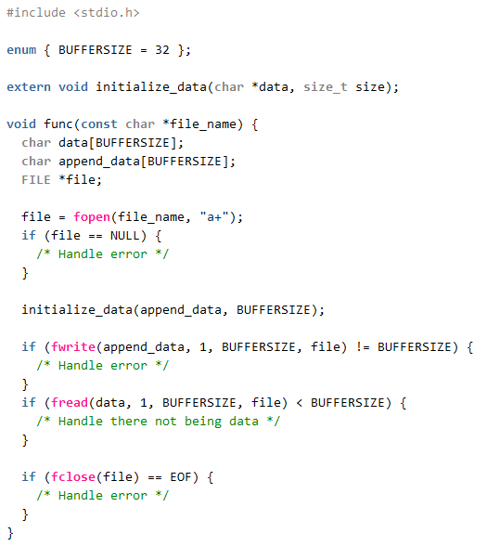
No flush() Between Write and Read
Example from CERT:
There is no flush() between the fwrite and fread operation.
The state of the file is undetermined and read might result in anything.
"Undetermined behaviour"
Insert fflush( file);

Slide 27
File I/O Vulnerabilities
Lang | Description | Severity | Likelihood | Remediation Cost | Risk
C | Avoid TOCTOU race conditions while accessing files | 3 | 2 | 3 | 18
C | Distinguish between characters read from a file and EOF | 3 | 2 | 2 | 12
C | Do not assume that fgets() returns a nonempty string when successful | 3 | 2 | 2 | 12
C | Do not alternately input and output from a stream without an intervening flush or positioning call | 1 | 3 | 2 | 6
C | Close files when they are no longer needed | 2 | 1 | 2 | 4
C | Do not access a closed file | 2 | 1 | 2 | 4
These are not really big security problems, just nuisances…
Table data after CERT.org
Note: ‘C’ in above table means ‘C and C++’

Slide 28

Summary
Classic C file I/O
  fprintf, fscanf and many more
  → same problems as formatted I/O
File I/O in C++ using streams
  can process entire structs in one go. Fast.
Both C and C++
  File I/O can go wrong in several places
  Apply a triple lock
Some non-obvious vulnerabilities
  TOCTOU, (EOF), and always remember to flush…

Slide 29
End of Lecture

